Slide 1
1. Characteristics of Clean Data and Messy Data
What exactly is clean data? Clean data is accurate, complete, and in a format that is ready to analyze. Characteristics of clean data include data that are:
Free of duplicate rows/values
Error-free (e.g. free of misspellings)
Relevant (e.g. free of special characters)
The appropriate data type for analysis
Free of outliers (or only contain outliers have been identified/understood), and
Follows a “tidy data” structure
Common symptoms of messy data include data that contain:
Special characters (e.g. commas in numeric values)
Numeric values stored as text/character data types
Duplicate rows
Misspellings
Inaccuracies
White space
Missing data
Zeros instead of null values

Slide 2
Data Cleaning is the process of transforming raw data into consistent data that can be analyzed. It is aimed at improving the content of statistical statements based on the data as well as their reliability. Data cleaning may profoundly influence the statistical statements based on the data.
R has a set of comprehensive tools that are specifically designed to clean data in an effective and comprehensive manner.

Slide 3


Slide 4
STEP 1: Initial Exploratory Analysis
The first step to the overall data cleaning process involves an initial exploration of the data frame that you have just imported into R. It is very important to understand how you can import data into R and save it as a data frame.
setwd(“C:/Users/NAGRAJ/Desktop/House Pricing“)
data<-read.csv(“Regression-Analysis-House Pricing.csv“,na.strings = “”)

Slide 5
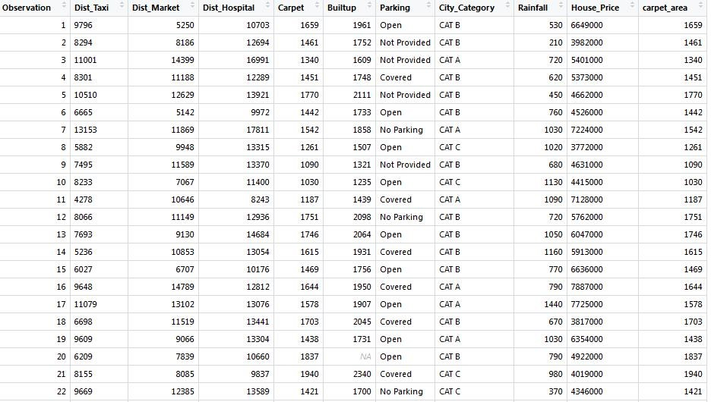

Slide 6
The first thing that you should do is check the class of your data frame:
class(data)
This renders an output as shown below in which we can clearly see that our dataset is saved as a data frame.
[1] “data.frame”

Slide 7
Next, we want to check the number of rows and columns the data frame has.
The code give us & its result:
dim(data)
[1] 932 10
Here we can see that the data frame has 932 rows and 10 columns.

Slide 8
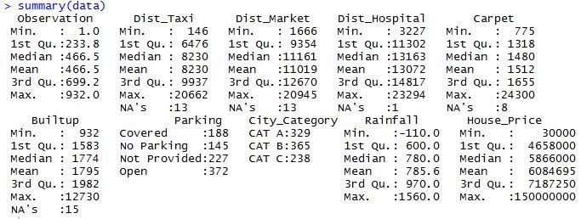
We can view the summary statistics for all the columns of the data frame using the code shown below: summary(data) This renders an output as shown below:

Slide 9
STEP 2: Visual Exploratory Analysis
There are 2 types of plots that you should use during your cleaning process –
The Histogram and
the BoxPlot

Slide 10
Histogram
The histogram is very useful in visualizing the overall distribution of a numeric column. We can determine if the distribution of data is normal or bi-modal or unimodal or any other kind of distribution of interest. We can also use Histograms to figure out if there are outliers in the particular numerical column under study. In order to plot a histogram for any particular column we need to use the code shown below:
install.packages(“plyr”)
library(plyr)
hist(data$Dist_Taxi)

Slide 11
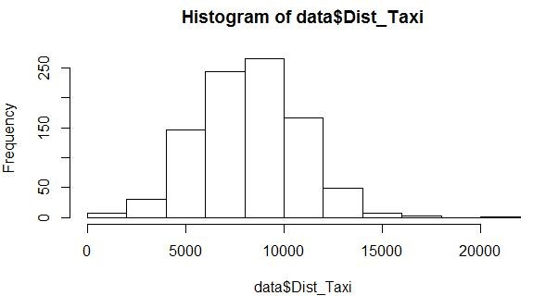

Slide 12
BoxPlot
Boxplots are super useful because it shows you the median, along with the first, second and third quartiles. BoxPlots are the best way of spotting outliers in your data frame. In order to visualize a box plot we need to use the code shown below:

Slide 13
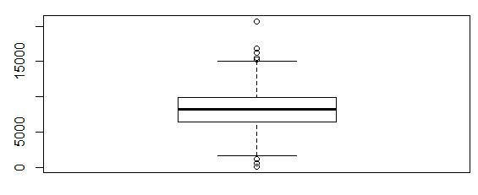
boxplot(data$Dist_Taxi)

Slide 14
STEP 3: Correcting the errors!
This step focuses on the methods that you can use to correct all the errors that you have seen.
If we want to change the name of our data frame we can do so using the code shown below:
data$carpet_area<-data$Carpet
In the code above we renamed the Carpet column as “Carpet_area”.

Slide 15
Sometimes columns have an incorrect type associated with them. For example, a column containing text elements stored as a numeric column. In such a case we can change the type of column by using the code shown below:
data$Dist_Taxi<-as.character(data$Dist_Taxi)
class(data$Dist_Taxi)

Slide 16
“character”
There are a wide array of type conversions you can carry out in R. They are listed below.
as.character()
as.numeric()
as.integer()
as.logical()
as.factor()

Slide 17
String manipulation in R comes in handy when you are working with datasets that have a lot of text based elements.
#Making all uppercase
data$Parking<-toupper(data$Parking)
#Making all Lowercase
data$Parking<-toupper(data$Parking)

Slide 18
If we want to trim the whitespaces in the next under a column we need to use the code shown below:
#Installing and loading the required packages
install.packages(“stringr”)
library(stringr)

Slide 19
#Trimming all whitespaces
data$Dist_Taxi<-str_trim(data$Dist_Taxi)
If we want to replace a particular word or letter under a column we can do so using the code below:
#Replacing “Not Provided” with “Not Available”
data$Parking<-str_replace(data$Parking,”Not Provided”,”Not Available”)
In order to replace the outliers with the summary statistics like median the following code is used.
#Replacing the outliers of a particular column with median
vec1<-boxplot.stats(data$Dist_Taxi)$out;
data$Dist_Taxi[data$Dist_Taxi %in% vec1]<-median(data$Dist_Taxi)

Slide 20
#Checking for missing values in the entire dataframe
any(is.na(data))

Slide 21
#Checking for the total number of missing values in the entire dataframe
sum(is.na(data))

Slide 22
#Checking for the total number of missing values in a particular column
sum(is.na(data$Dist_Taxi))

Slide 23
#Eliminating missing values completely from the entire dataframe
na.omit(data)

Slide 24
#Checking for missing values in the entire dataframe
any(is.na(data))
#Checking for the total number of missing values in the entire dataframe
sum(is.na(data))
#Checking for the total number of missing values in a particular column
sum(is.na(data$Dist_Taxi))
#Eliminating missing values completely from the entire dataframe
na.omit(data)
#Eliminating missing values completely from a particular column
na.omit(data$Dist_Taxi)
#Replacing the NA’s in the entire dataframe with ‘0’s
data[is.na(data)]<- 0

Slide 25
#Replacing the NA’s in a particular column with ‘0’s
data$Dist_Taxi[is.na(data$Dist_Taxi)]<-0
#Replacing the NA’s in a particular column with a summary statistics like median
data$Dist_Taxi[is.na(data$Dist_Taxi)]<-median(data$Dist_Taxi)
Suppose we want to unite two columns in our data frame we can do so using the code shown below:
#Installing and loading the required package
install.packages(“tidyr”)
library(tidyr)
data1<-unite(data = data,col = city_category_with_parking,City_Category,Parking)
View(data1)
The unite() function takes 4 arguments – The data frame, the new column name, the first column and the second column name that you want to unite.
Conversely we can also separate a column as shown below:
data2<-separate(data = data1,city_category_with_parking,c(“City_Category”,”Parking”), sep = “-“)
View(data2)
The separate() function takes 4 arguments – The data frame, the column that we want to separate, the names of the new columns and the indicator at which we want the column to be separated at.
steps 1 to 3 above gives you a relatively clean dataset. Always keep exploring new ways that you can clean your data and never stop exploring.

Slide 26
outliers
An outlier is a value or an observation that is distant from other observations, that is to say, a data point that differs significantly from other data points. Enderlein (1987) goes even further as the author considers outliers as values that deviate so much from other observations one might suppose a different underlying sampling mechanism.
An observation must always be compared to other observations made on the same phenomenon before actually calling it an outlier. Indeed, someone who is 200 cm tall (6’7" in US) will most likely be considered as an outlier compared to the general population, but that same person may not be considered as an outlier if we measured the height of basketball players.
An outlier may be due to the variability inherent in the observed phenomenon. For example, it is often the case that there are outliers when collecting data on salaries, as some people make much more money than the rest. Outliers can also arise due to an experimental, measurement or encoding error. For instance, a human weighting 786 kg (1733 pounds) is clearly an error when encoding the weight of the subject. Her or his weight is most probably 78.6 kg (173 pounds) or 7.86 kg (17 pounds) depending on whether weights of adults or babies have been measured.
For this reason, it sometimes makes sense to formally distinguish two classes of outliers: (i) extreme values and (ii) mistakes. Extreme values are statistically and philosophically more interesting, because they are possible but unlikely responses. (Thanks Felix Kluxen for the valuable suggestion.)
There are several approaches to detect outliers in R, from simple techniques such as descriptive statistics (including minimum, maximum, histogram, boxplot )

